Slide 1
Progress Slides
Gaurav Pachauri, Name 2
email@goa.bits-pilani.ac.in
Department of Electrical and Electronics Engineering

Slide 2
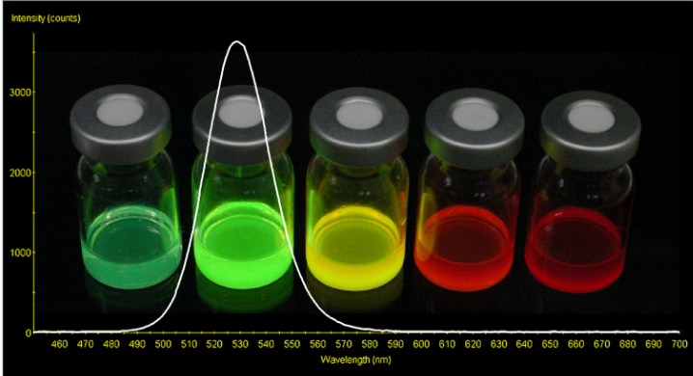
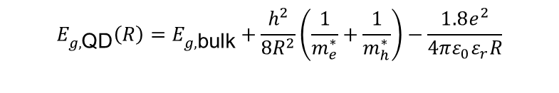
Structure and Quantum Confinement
Bare CdSe Quantum dots
Nanoscale Core: Direct bandgap semiconductor with crystal diameter typically ranging from 2 to 8 nm.
Size-Tunable Photoluminescence: Emission spans the visible spectrum due to quantum confinement effects.
High Surface Atom Ratio: Up to 80% of constituent atoms reside on the physical particle boundary.
$$E_{g,\text{QD}}\left(R\right)=E_{g,\text{bulk}}+\frac{h^{2}}{8R^{2}}\left(\frac{1}{m_{e}^{∗}}+\frac{1}{m_{h}^{∗}}\right)−\frac{1.8e^{2}}{4πε_{0}ε_{r}R}$$

Slide 3
Core CdSe Limitations
Surface Trap States: Unpassivated dangling bonds on the surface create localized energy states within the bandgap, rapidly trapping exciton charge carriers.
Low Quantum Yield: Dominant non-radiative recombination pathways significantly reduce Photoluminescence Quantum Yield (PLQY < 20% at room temperature).
Photochemical Instability: Unprotected CdSe cores suffer from rapid photo-oxidation under UV irradiation, causing spectral blue-shifts and signal degradation.

Slide 4
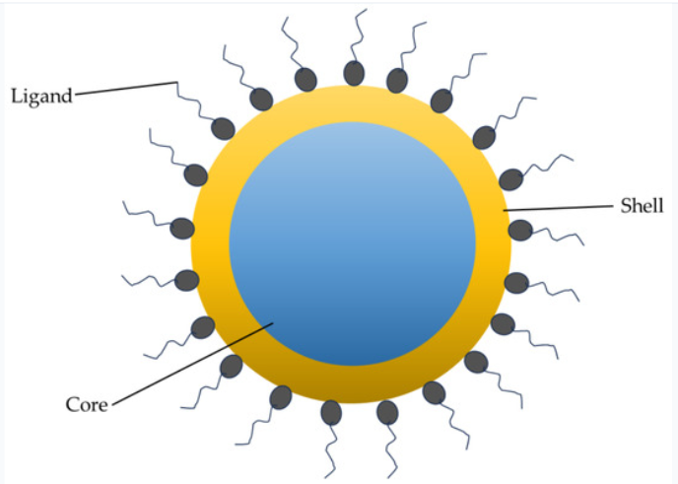
Core/Shell Cdse Architecture
Epitaxial Shell Passivation
Inorganic Shell Coating: Growing a wider bandgap semiconductor shell (e.g., ZnS or CdS) over the CdSe core.
Type-I Band Alignment: Conduction and valence band edges of the shell enclose the core, confining excitons inside CdSe.
Elimination of Traps: Surface dangling bonds are electronically passivated, suppressing non-radiative decay.
Environmental Shield: Physical barrier isolates the core from oxygen, moisture, and chemical quenchers.

Slide 5
Bare vs. Core/Shell Comparison
Property/Metric | Bare CdSe Core | CdSe/ZnS Core/Shell
PL Quantum Yield | Low(5%-20%) | Very High (50%-90%)
Photostability | Poor | Exceptional
Surface Detect Trap States | High Density of Dangling Bonds | Electronically Passive Interface
Exciton Confinement | Exposed to external Environment | Strong Type-1 spatial confinement
Primary Applicaitons | Basic Spectroscopic research | QLED Displays, Bio-Imaging, Photovoltaics

